Slide 1
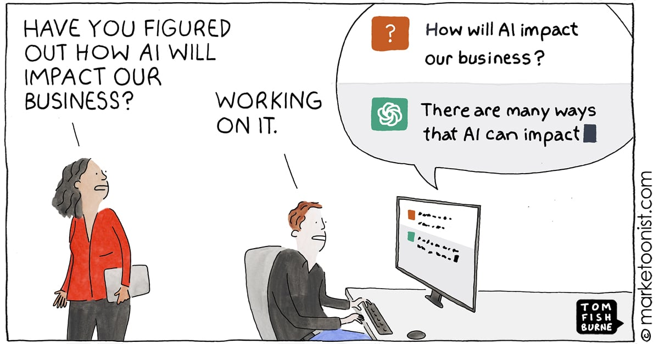

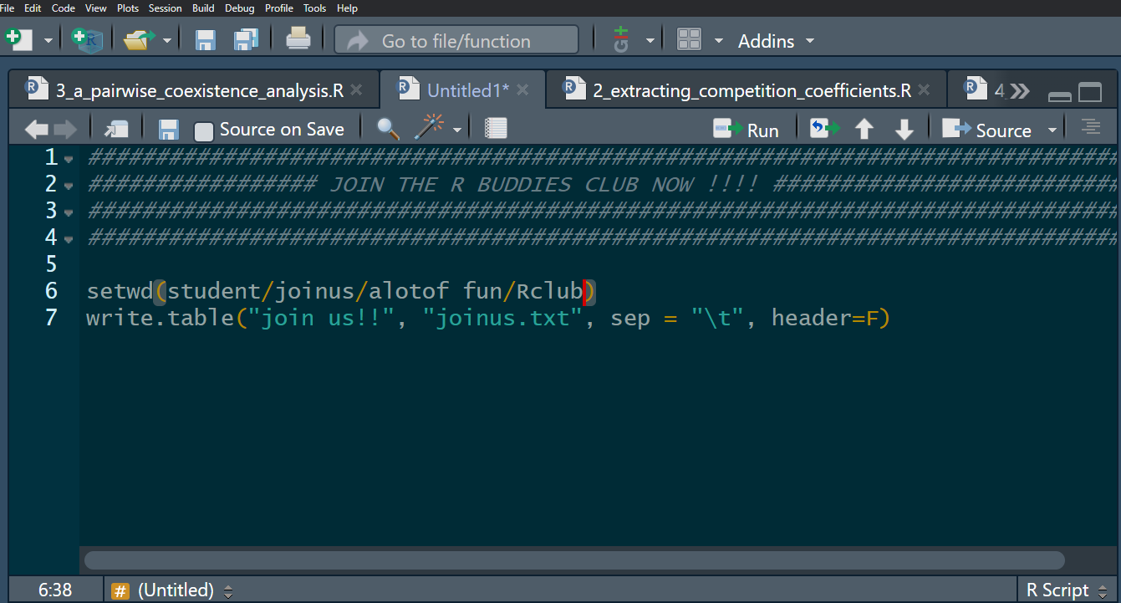

coding
Welcome to the…
CODING
Session 1:
~ Introduction to coding with AI ~
By
Caroline Daniel,
Postdoc at the IEE
R
Buddies
Club

Slide 2


The spectrum of AI usage
Asking AI for cookies recipe
Asking AI for major life-changing decisions

Slide 3
The spectrum of AI usage
Asking AI for cookies recipe
Asking AI for major life-changing decisions
How long has it been since you took an important decision without asking an LLM about it?

Slide 4

The disappearance of skills, are we becoming stupid?
What’s the cost of AI, what skills are going to be lost?
Is that so bad/different compared to the impact that other technologies have had in the past?
What about…
Writing philosophy
Calculator
Wikipedia
GPS

Slide 5

The scientific evidence, how do we learn?
The three steps of learning:
Collecting information (building new neural pathways)
Practicing finding back the information (reinforcing neural pathways)
Criticising the information found (meta-cognition, neural pathway of reward)
Your Brain on ChatGPT: Accumulation of Cognitive Debt when using AI assistant for essay writing task
source: www.youtube.com/@Micode

Slide 6
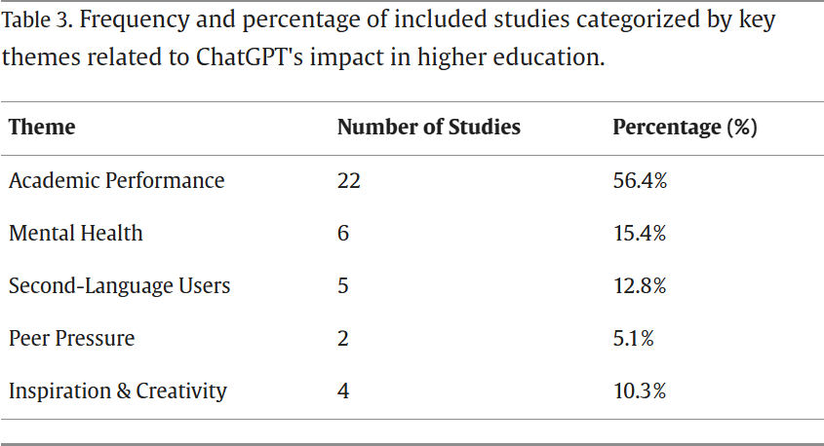
Good sides… Bad sides
Systematic review of ChatGPT in higher education: Navigating impact on learning, wellbeing, and collaboration
Conclusions (citation):
“Value-add through personalization and immediacy, ChatGPT excels at micro-scaffolded guidance, anxiety reduction, and multilingual support.

Slide 7
Good sides… Bad sides
Systematic review of ChatGPT in higher education: Navigating impact on learning, wellbeing, and collaboration
Conclusions (citation):
“Value-add through personalization and immediacy, ChatGPT excels at micro-scaffolded guidance, anxiety reduction, and multilingual support.
Risk of skill atrophy through over-reliance, critical thinking, deep reading and original ideation can suffer when AI responses are taken at face value.”

Slide 8
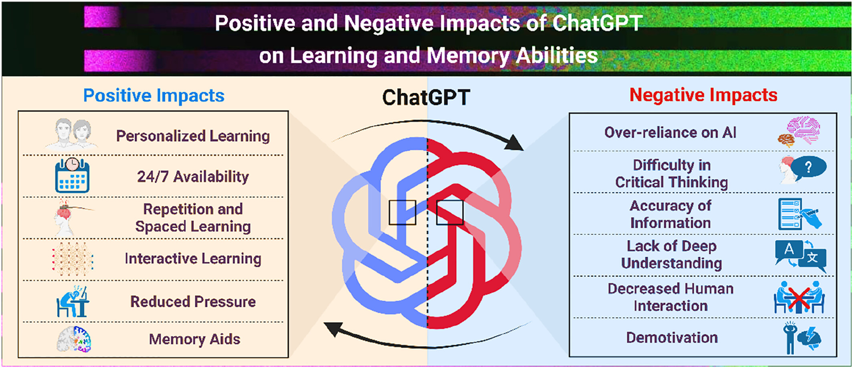
Good sides… Bad sides
Vector of equality or inequalities?
ChatGPT: The cognitive effects on learning and memory

Slide 9
Good sides… Bad sides
Vector of equality or inequalities?
Too much data, unlimited access to information
ChatGPT: The cognitive effects on learning and memory

Slide 10
Good sides… Bad sides
Vector of equality or inequalities?
Too much data, unlimited access to information
The productivity race, winning time… Whatever the cost
ChatGPT: The cognitive effects on learning and memory

Slide 11
Good sides… Bad sides
Vector of equality or inequalities?
Too much data, unlimited access to information
The productivity race, winning time… Whatever the cost
Giving confidence to try new tasks
ChatGPT: The cognitive effects on learning and memory

Slide 12
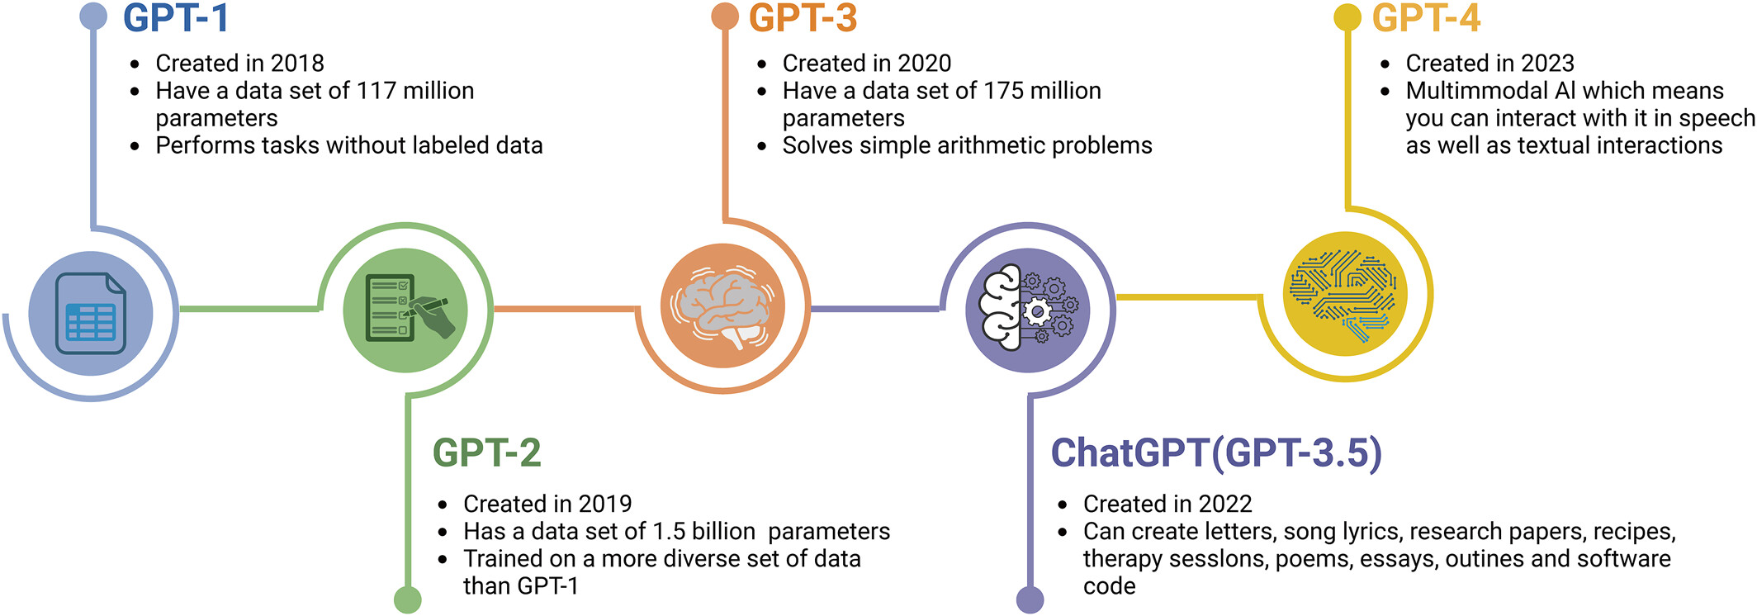
A race against the times
ChatGPT: The cognitive effects on learning and memory

Slide 13
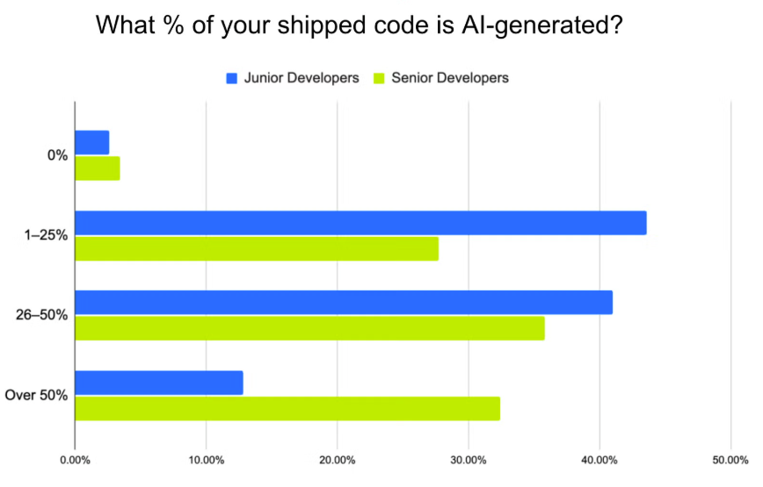
Going sober, when to quit AI
Vibe Shift? Senior Developers Ship nearly 2.5x more AI Code than Junior Counterparts

Slide 14
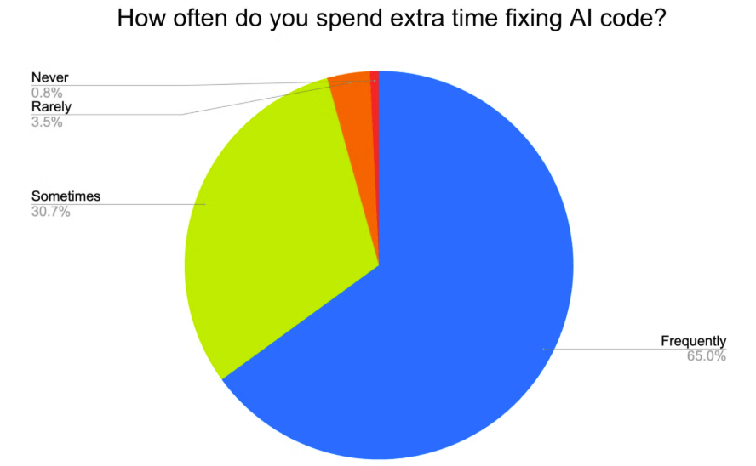
Going sober, when to quit AI
This survey was conducted by Fastly from July 10 to July 14, 2025, with 791 professional developers. All respondents confirm that writing or reviewing code is a core part of their job. The survey is distributed in the US and quality-controlled for accuracy, though, as with all self-reported data, some bias is possible.

Slide 15
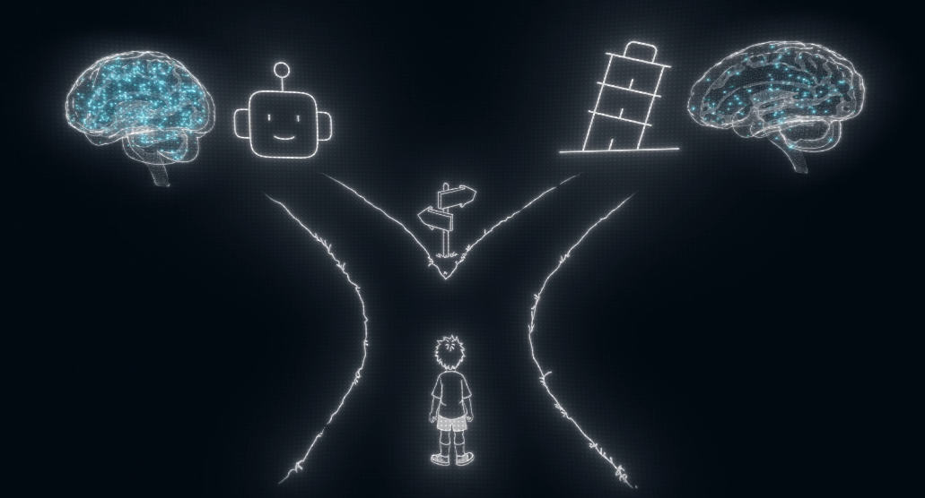
Going sober, when to quit AI
source: www.youtube.com/@Micode

Slide 16

Going sober, when to quit AI
Enforcing strong boundaries on your own AI use
source: www.youtube.com/@Micode

Slide 17

R club, program and milestones
Session 1: AI introduction and building a personal code of conduct for AI use (February)
Session 2: What type of AI is there? What’s their differences? (March)
Session 3: Building your own AI tool (April)
Session 4: Building your own AI tool (May)
Session 5: Assignment, producing a R script made with the help of your AI tool (June)

Slide 18
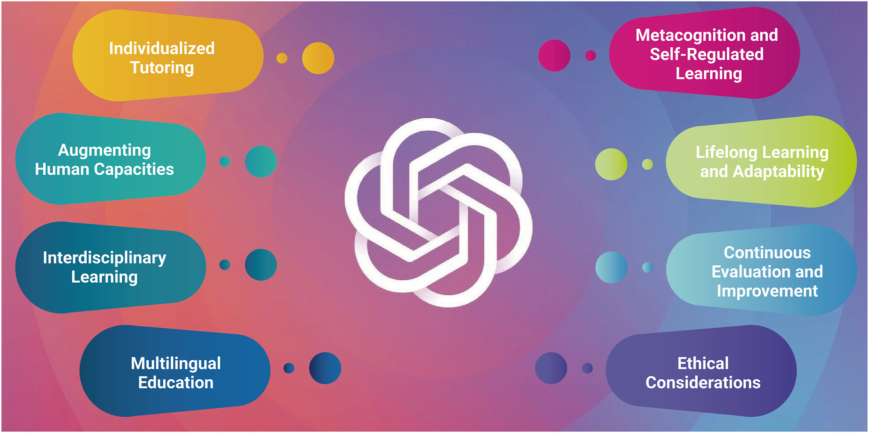
Conclusion
ChatGPT: The cognitive effects on learning and memory

